Slide 2
Facilitate the Game
This game is based on Evidence Based Management (EBM). EBM is an empirical framework organizations can use to help measure (perceived) product value, and the way they deliver their product(s). The measurements can be inspected to help maximize product value and improve the way of working.
As a Scrum Facilitator, put the four Key Value Areas (KVAs) in a row on the floor (Current Value, Time to Market, Ability to Innovate and Unrealized Value). Explain each KVA to the participants.
Form two groups and hand one group the green Key Value Measures cards (KVMs) and the other group the remaining purple KVMs.
Step 1: Invite the group(s) to discuss and put the KVMs under the correct KVA.
Step 2: Invite both groups to discuss their results and adapt their cards. Make sure by the end of this round, the KVM cards are under the correct KVA.
Step 3: Invite the participants to individually look at the KVMs and select one KVM that caught their attention. (A non-EBM KVM may also be chosen at this point)
Step 4: Invite the participants into groups of four. Ask each participant to explain why they chose their particular KVM and collaborate on how to implement it. (In case of non-EBM measures, pay attention that these are not vanity metrics and discuss the potential pitfalls)
Based on the 2020 EBM Guide. http://scrum.org/EBM
The Measuring Outcome game v2.2.2 is licensed under CC BY-NC-SA 4.0 by Scrum Facilitators

Slide 3
CURRENT VALUE
The Value that the product delivers today

Slide 5
UNREALIZED VALUE
The potential future value that could be realized
if the organization met the needs of all potential customers or users

Slide 7
TIME TO MARKET
The organization’s ability to quickly deliver new capabilities, services, or products

Slide 9
ABILITY TO INNOVATE
The effectiveness of an organization to deliver new capabilities
that might better meet customer needs

Slide 11
Customer Satisfaction

Slide 12
Customer Satisfaction

Slide 13
Defect Trends

Slide 14
Defect Trends

Slide 15
Product Cost Ratio

Slide 16
Product Cost Ratio

Slide 17
Change Failure Rate

Slide 18
Change Failure Rate

Slide 19
Installed Version Index

Slide 20
Installed Version Index

Slide 21
Desired Customer Experience or satisfaction

Slide 22
Desired Customer Experience or satisfaction

Slide 23
Time to remove Impediment

Slide 24
Time to remove Impediment

Slide 25
Build & Integration Frequency

Slide 26
Build & Integration Frequency

Slide 27
Time to Pivot

Slide 28
Time to Pivot

Slide 29
Production Incident Count

Slide 30
Production Incident Count

Slide 31
Release Stabilization Period

Slide 32
Release Stabilization Period

Slide 33
Lead Time for Changes

Slide 34
Lead Time for Changes

Slide 35
Market Share

Slide 36
Market Share

Slide 37
Customer Cycle Time

Slide 38
Customer Cycle Time

Slide 39
Time-to-Learn

Slide 40
Time-to-Learn

Slide 41
Employee Satisfaction

Slide 42
Employee Satisfaction

Slide 43
Customer Usage Index

Slide 44
Customer Usage Index

Slide 45
Revenue per Employee

Slide 46
Revenue per Employee

Slide 47
Release Frequency

Slide 48
Release Frequency

Slide 49
Mean Time to Repair

Slide 50
Mean Time to Repair

Slide 51
Lead Time

Slide 52
Lead Time

Slide 53
Innovation Rate

Slide 54
Innovation Rate

Slide 55
On-Product Index

Slide 56
On-Product Index

Slide 57
Deployment Frequency

Slide 58
Deployment Frequency

Slide 59
Technical Debt

Slide 60
Technical Debt

Slide 61
Time to Restore Service

Slide 62
Time to Restore Service

Slide 63
Active (Product) Code Branches

Slide 64
Active (Product) Code Branches

Slide 65
Time Spent Merging Code Between Branches

Slide 66
Time Spent Merging Code Between Branches

Slide 67
Time Spent Context-Switching

Slide 68
Time Spent Context-Switching

Slide 69
Customer or User Satisfaction Gap

Slide 70
Customer or User Satisfaction Gap

Slide 71
Don’t measure Output. Measure Outcomes

Slide 73
It’s not about the Metrics, but about the Conversation

Slide 75
Learn more about Evidence Based Management at http://scrum.org/EBM

Slide 77
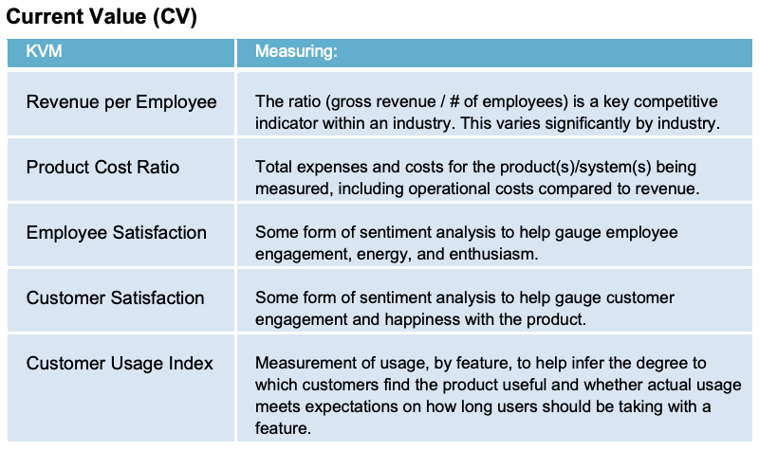
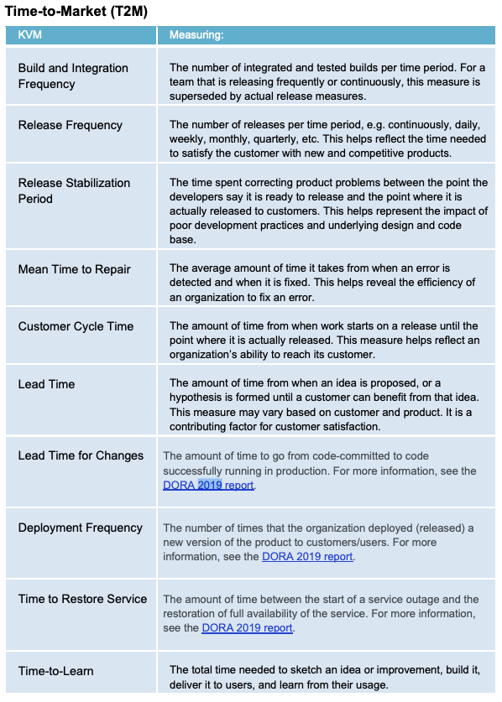
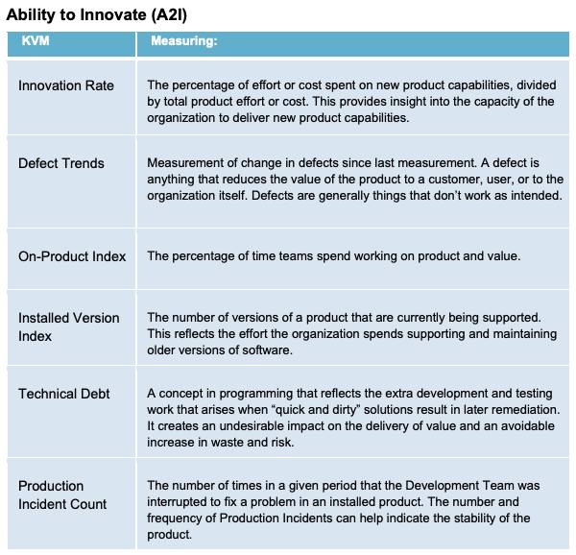
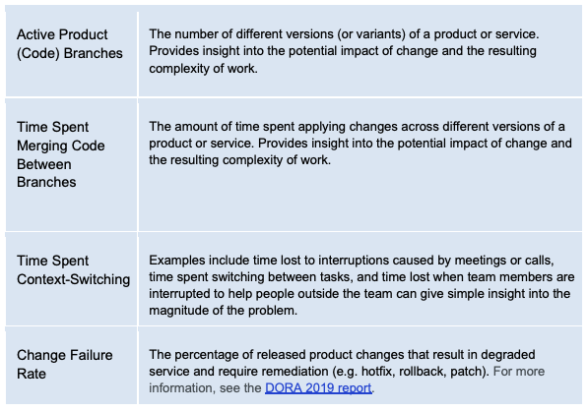
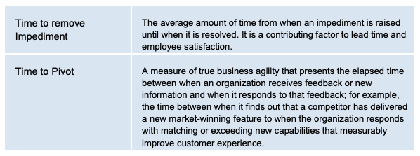
EBM Example Key Value Measures cheat sheet
Source: EBM guide 2020, http://scrum.org/EBM

